Slide 1

Liv-Lyf V-2.0
A Hospital cum Management Web Application

Slide 2

Motivation
To solve the problem people face when they are in search of hospital beds, vaccines, or while visiting some place having concern of number of cases in that area. To empower people to know the actual and live status of Vaccination Centre and Hospitals.
Building a project to help society and ease life of people.
And to promote Digital India (“Power to Empower”).

Slide 3
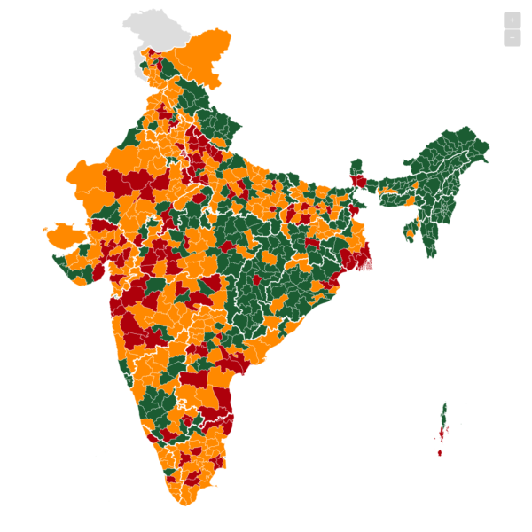


Liv-Lyf
Will be helpful in finding Number of Active cases- places by looking at COVID Positive Patient from the given region.
Will be capable of showing Live-Vaccination Status

Slide 4
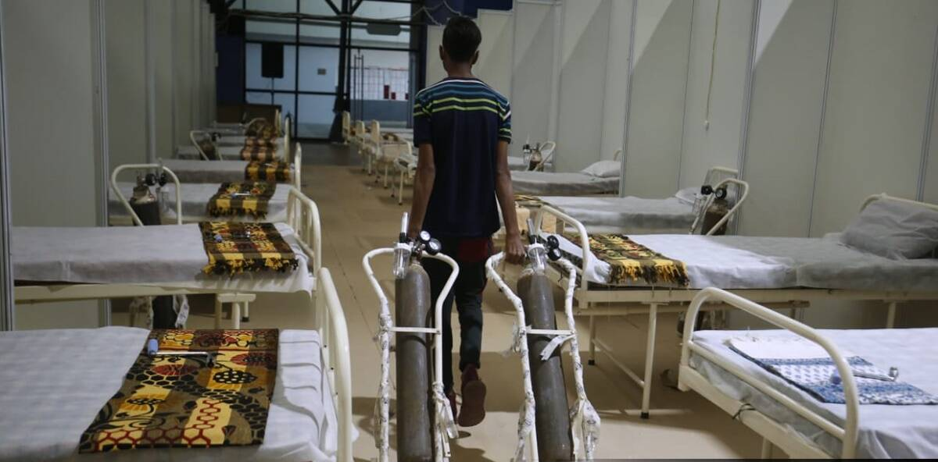

Liv-Lyf
Will be providing live Hospital-status of available beds and oxygen-cylinder locality-wise/ hospital-wise/city-wise.
Will be empowering India by providing honest and transparent status of hospital and vaccination center on the fingertips of every-person

Slide 5
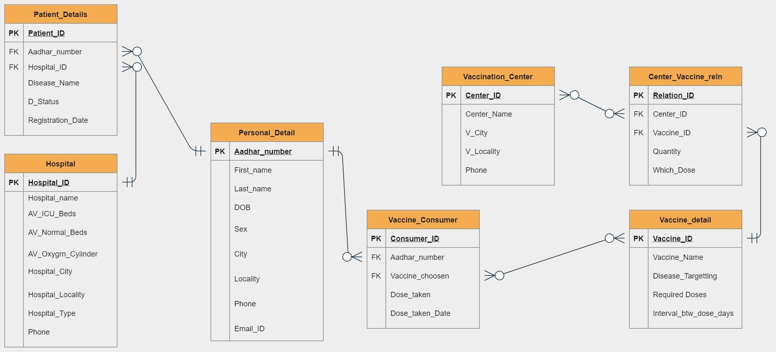
ER Diagram of Liv-Lyf Database
Hospital-Patients
Vaccination-Centers
Vaccination-Center
Hospital-Patient

Slide 6
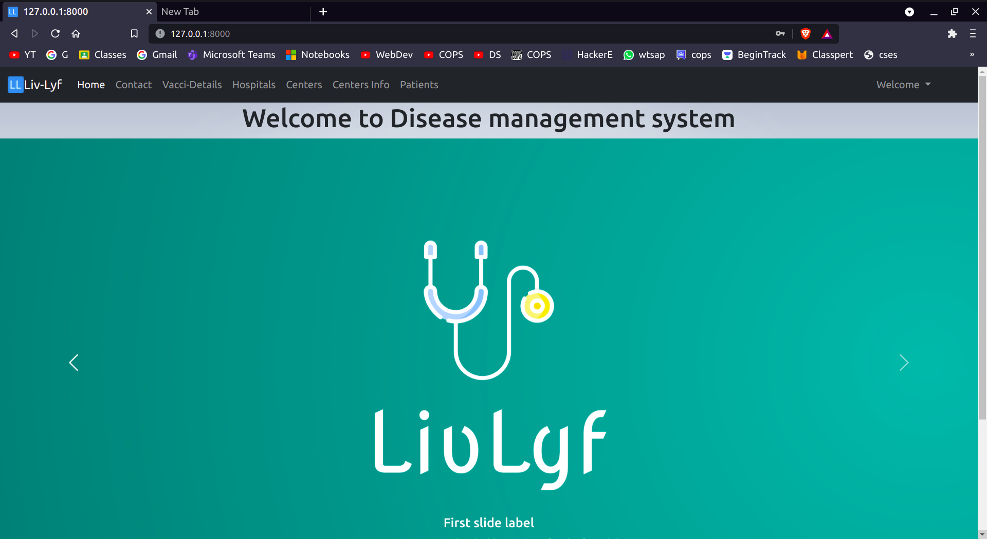
HOME PAGE

Slide 7
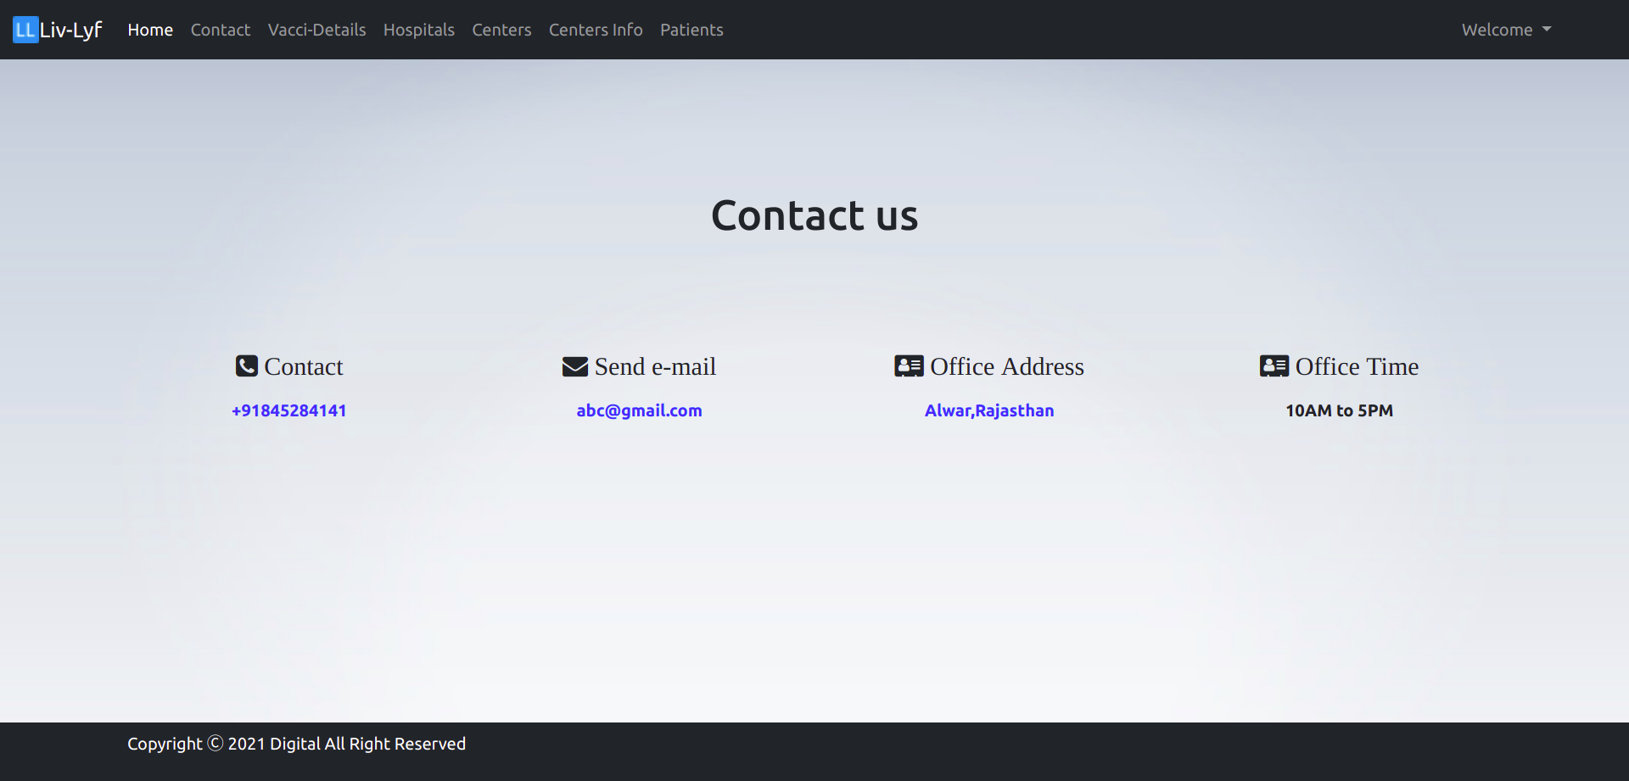
Contact Us page for any queries:-

Slide 8
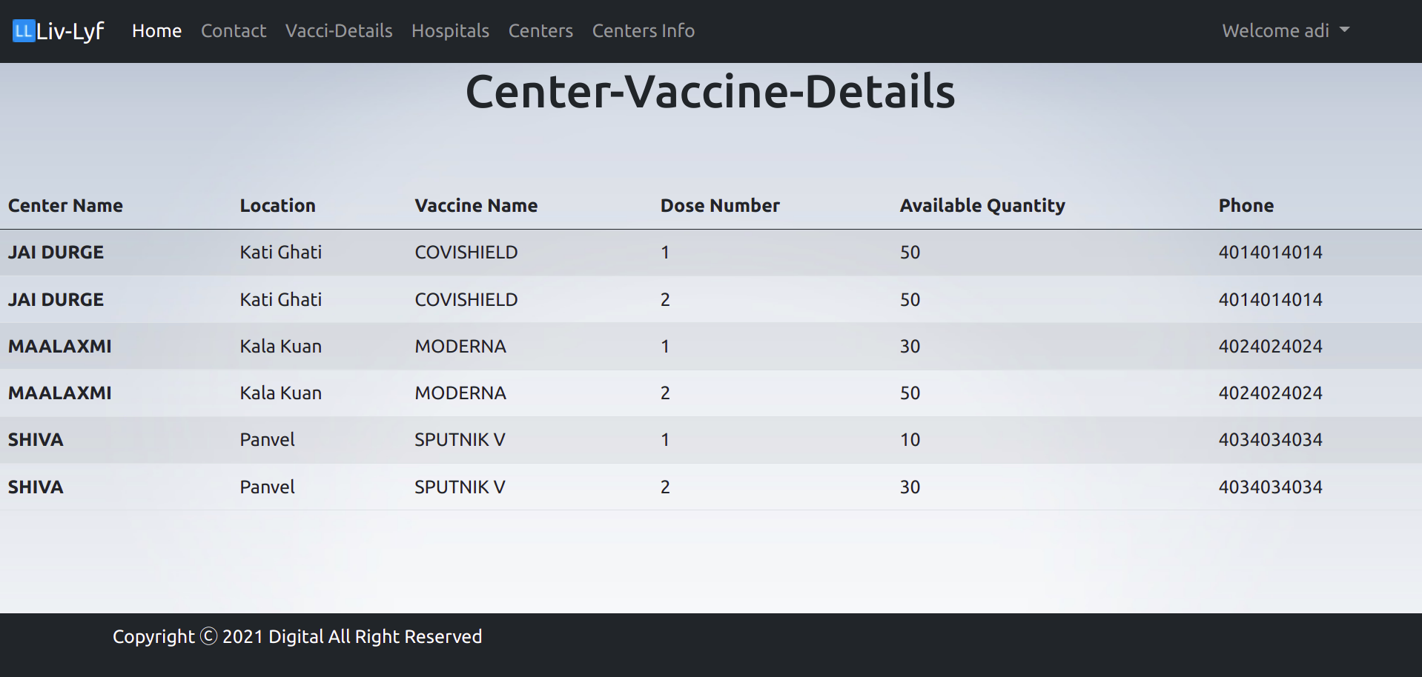

Slide 9
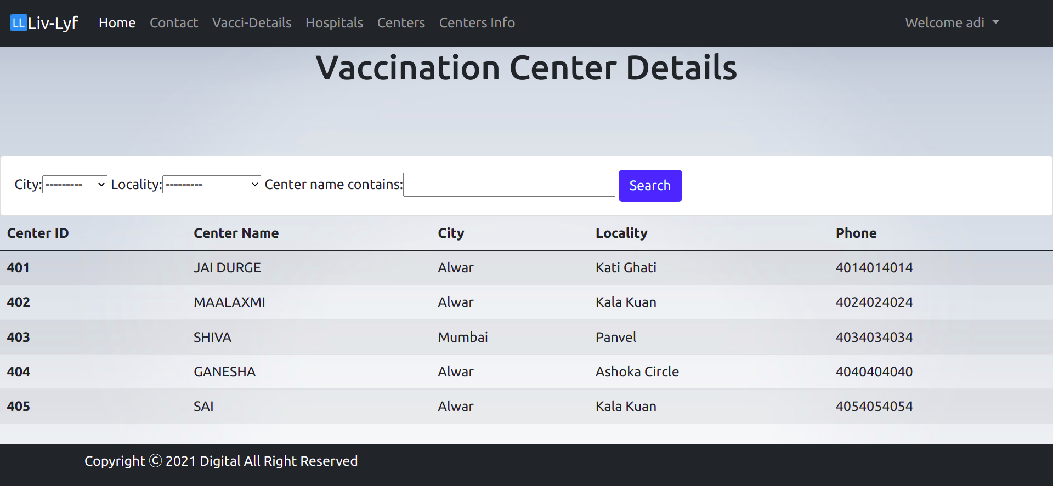
Check availability of vaccines in your nearby centre

Slide 10
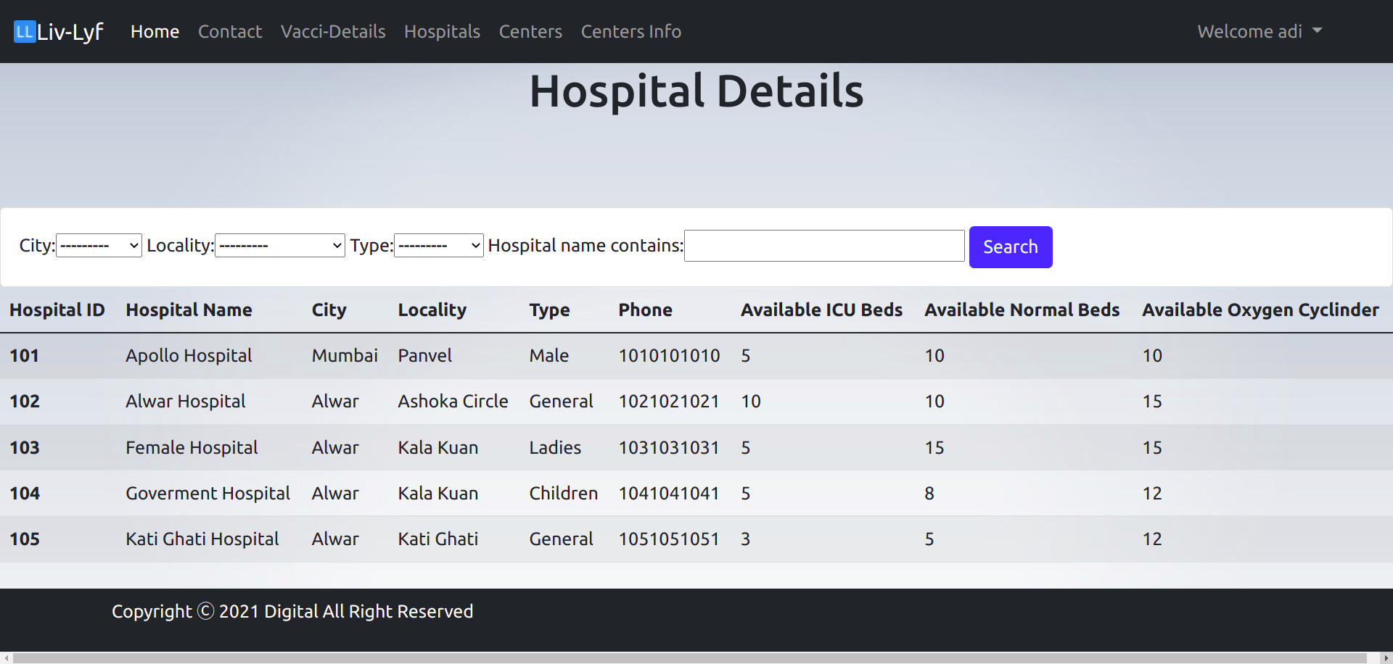
Find Hospital Details (Beds, Cylinders) as per your requirement

Slide 11
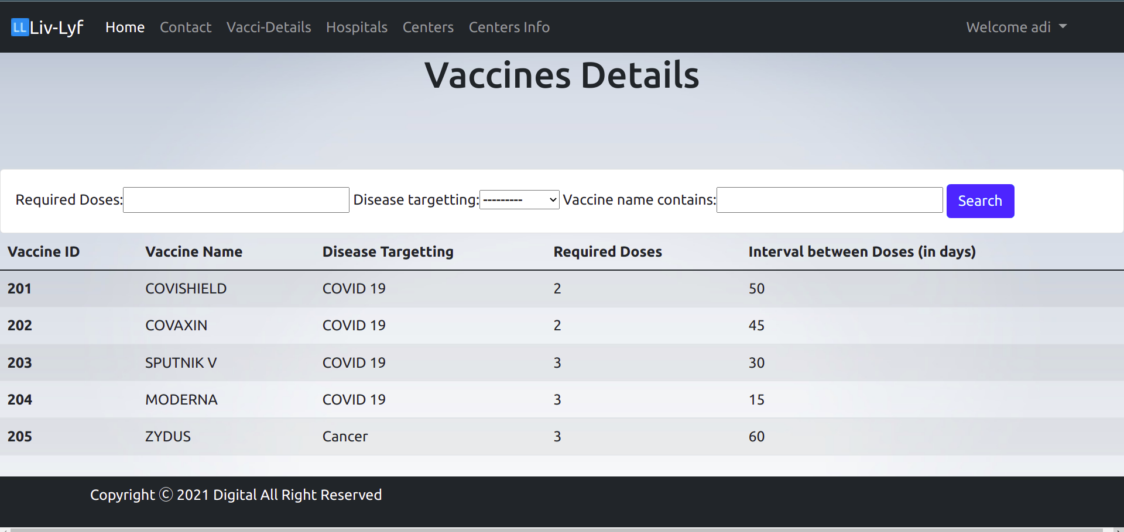

Slide 12
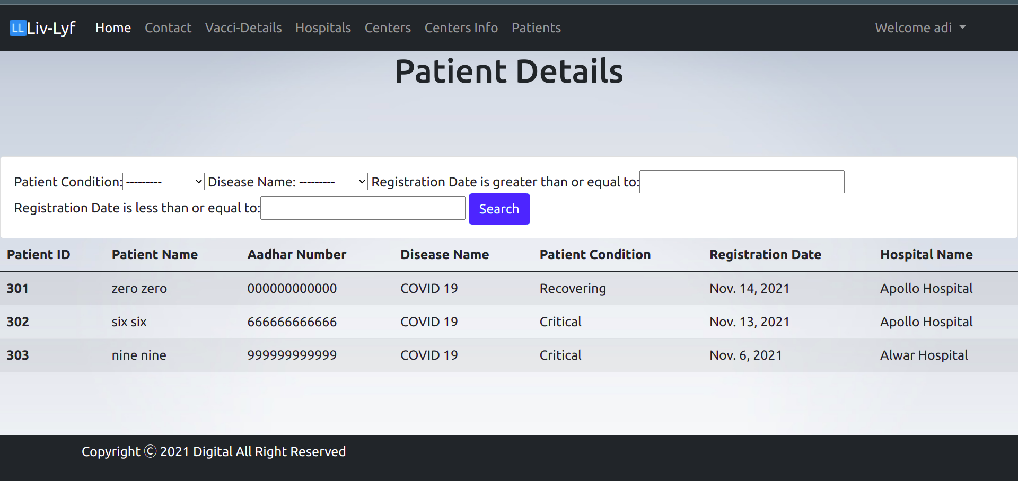

Slide 13
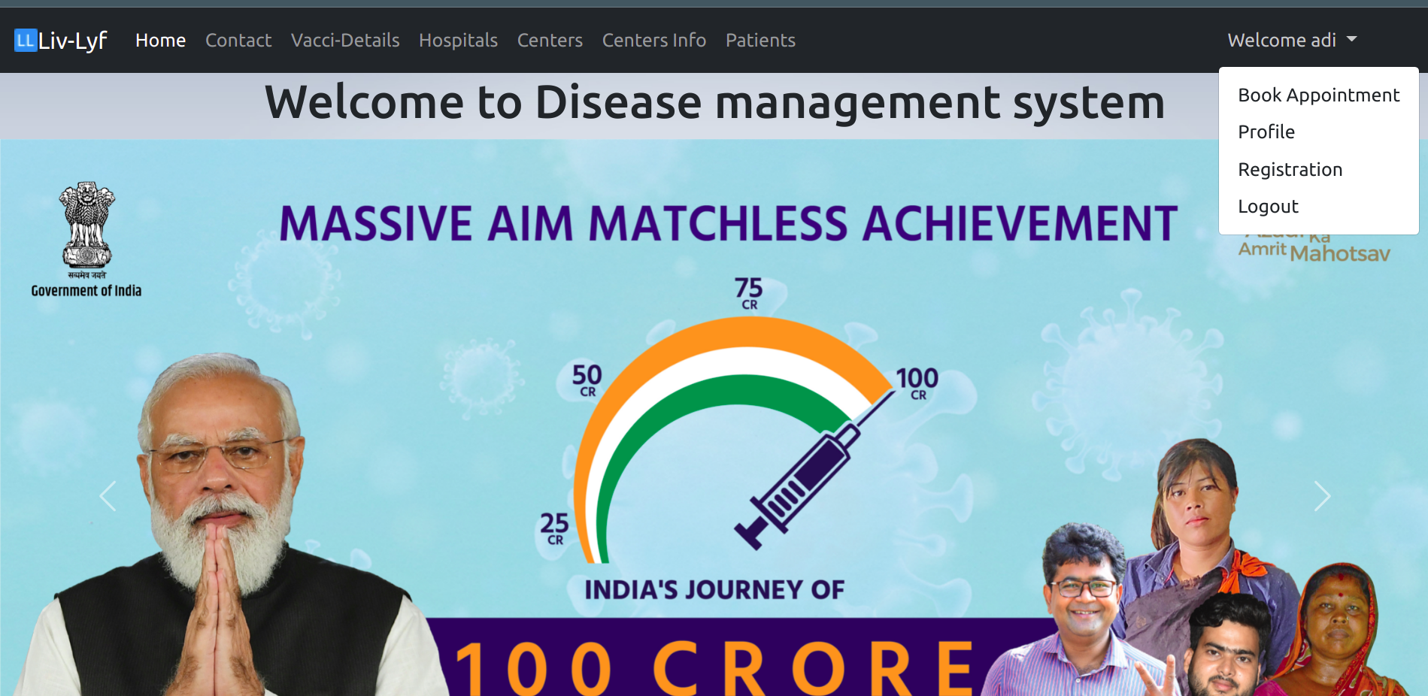

Slide 14
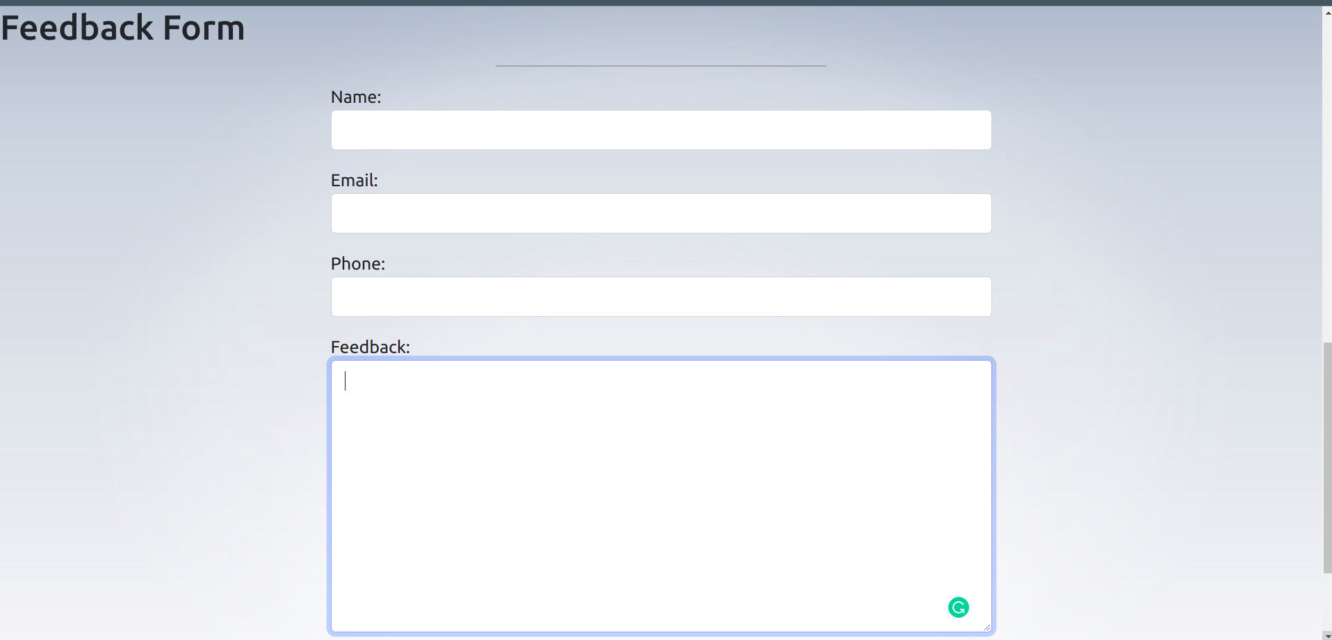
Opinion about vaccination centres or any thing

Slide 15
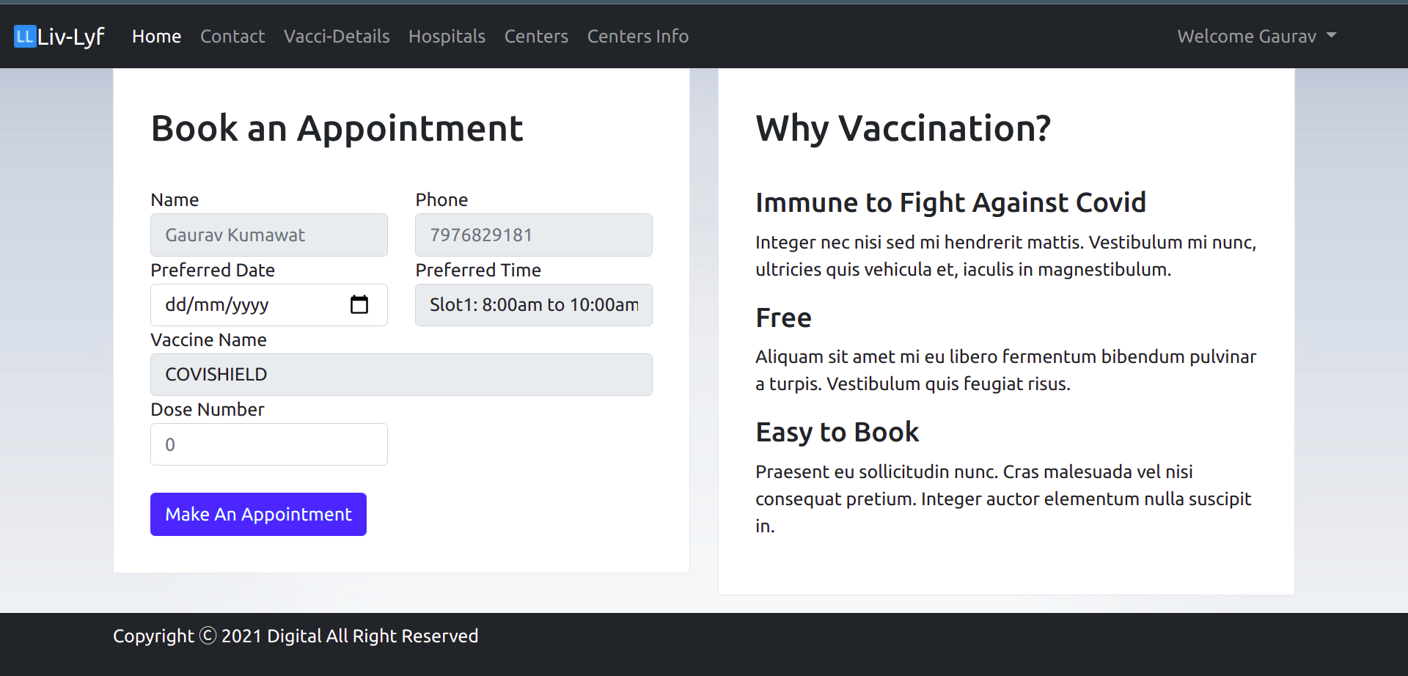
Booking of Vaccination

Slide 16
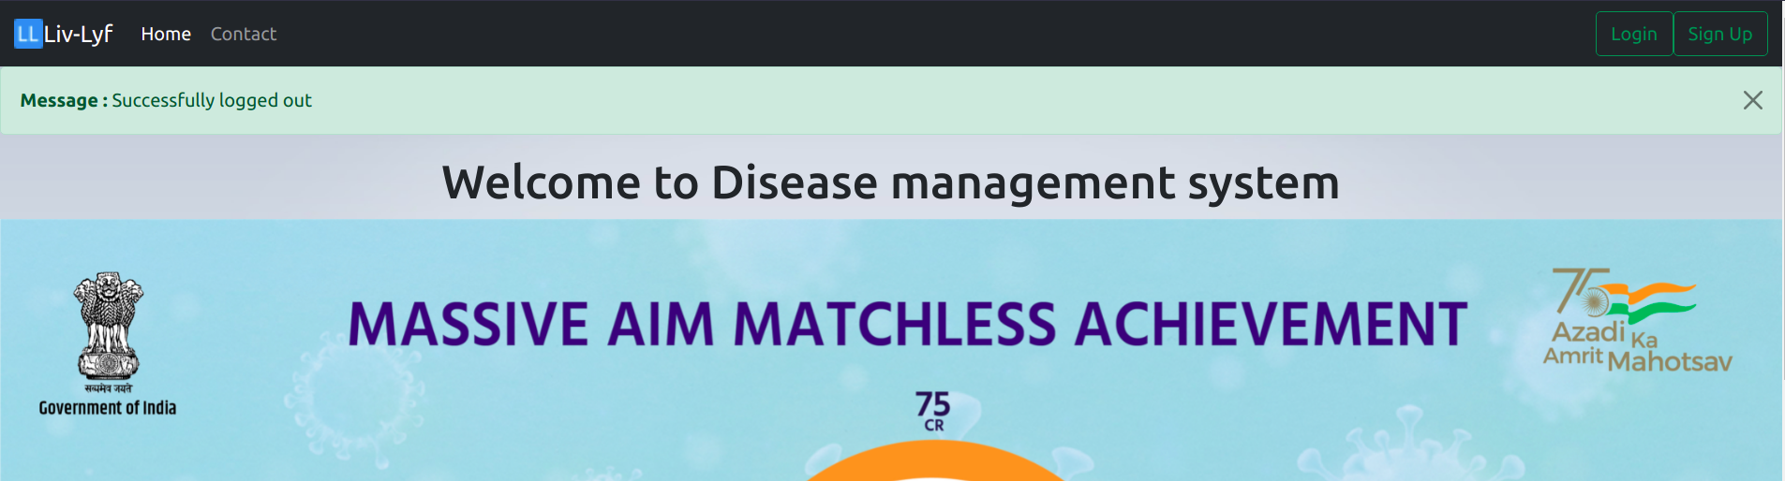
Displaying Messages

Slide 17
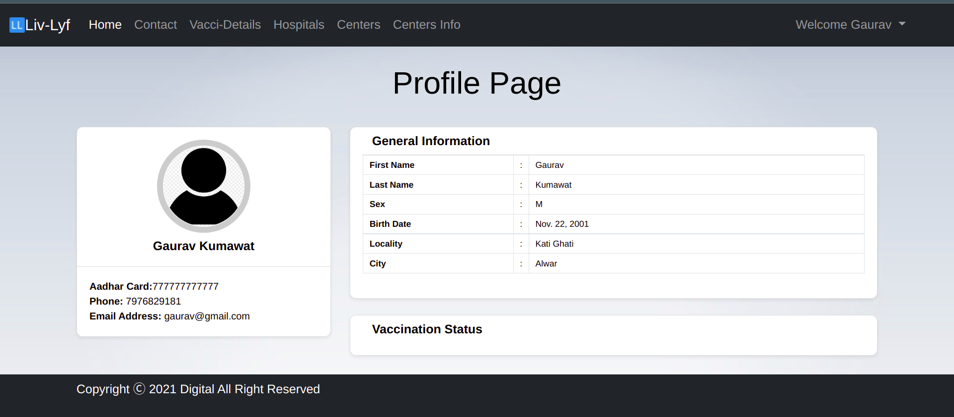
Profile Page to see personal details and Vaccination Status

Slide 18

Future Plans
1. OTP-Verification
2. API Implementation
3. Appointment Settings
4. Providing Better User_Interface
5. Payment Feature
6. Chat-Bot
7. Deployment

Slide 19

And Much More to Come...
Feel Free to check our Updates on GitHub.
Liv-Lyf

Slide 20
Thank You
For Your Attention...
Project by-
Gaurav Kumawat (20075033)

